Slide 1

Hardware Production Tech- TCS34725
Daksh rana - N01664095

Slide 2
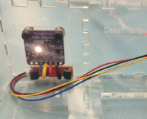
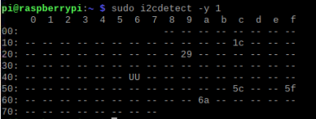
Mounted sensor & i2c Address:-

Slide 3
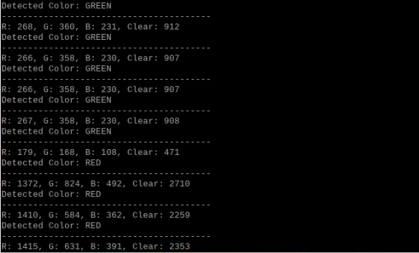
Readings:-

Slide 4
Sensor Name: TCS34725 RGB Color Sensor I2C Address: 0x29 Communication: I²C Bus 1 Function: Detects Red, Green, Blue, and Clear light levels to determine object color.
TCS34725 works via I²C at 0x29.
RGB + Clear readings update correctly.
Color detection identifies red and green.
Sensor is securely mounted with LED active.

